Slide 1


Deep Learning Methods For Automated Discourse
CIS 700-7
Fall 2017
http://dialog-systems-class.org/
João Sedoc with Chris Callison-Burch and Lyle Ungar
joao@upenn.edu
January 31st, 2017

Slide 2
Logistics
Please fill out the class poll
www.seas.upenn.edu/~joao/qc7.html
Three guest lectures coming up.

Slide 3


Neural Network Language Models (NNLMs)
Output
Output
Output
aardvark = 0.000041
aardvark = 0.000054
aardvark = 0.0082
…
…
…
drove = 0.045
to = 0.267
store = 0.0191
…
…
…
zygote = 0.00003
zygote = 0.000009
zygote = 0.003
Hidden 2
Recurrent Hidden
Recurrent Hidden
Hidden 1
Embedding
Embedding
Embedding
Embedding
Embedding
Embedding
he
drove
he
drove
to
the

Slide 4
Long Short Term Memory Models (LSTMs)
&
Gated Recurrent Units
(GRU)

Slide 5
Long Short Term Memory (LSTM)
Hochreiter & Schmidhuber (1997) solved the problem of getting an RNN to remember things for a long time (like hundreds of time steps).
They designed a memory cell using logistic and linear units with multiplicative interactions.
Information gets into the cell whenever its “write” gate is on.
The information stays in the cell so long as its “keep” gate is on.
Information can be read from the cell by turning on its “read” gate.

Slide 6

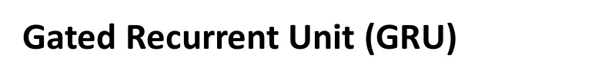
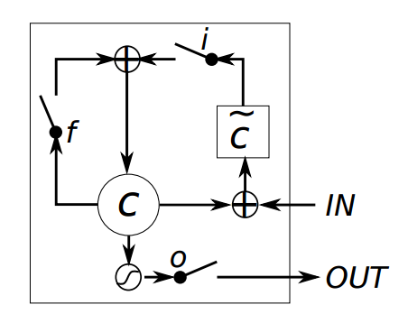
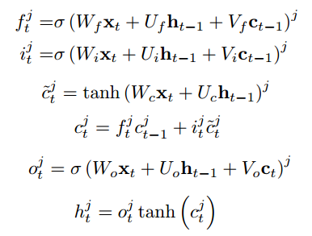
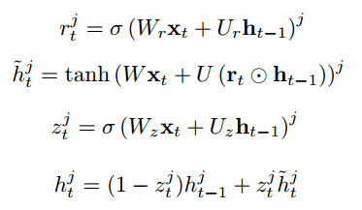
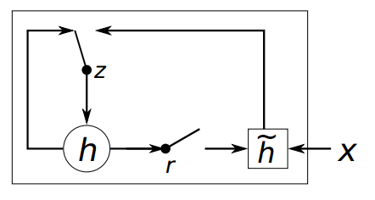

Recurrent Architectures
LSTM/GRU work much better than standard recurrent
  They also work roughly as well as one another

Slide 7
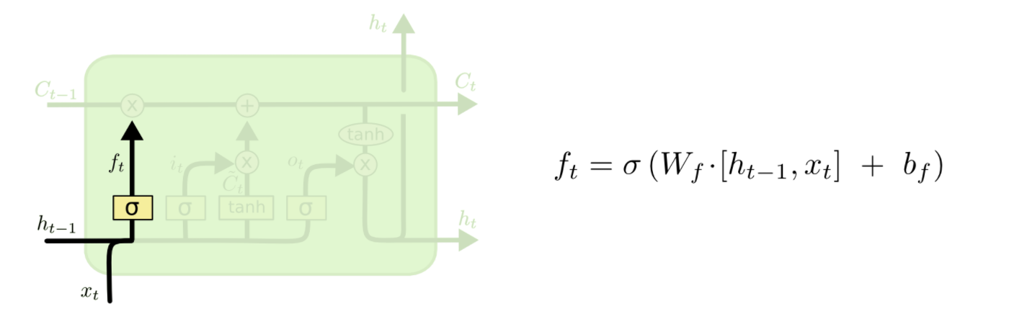
LSTM – Step by Step
From: Christopher Olah's blog http://colah.github.io/posts/2015-08-Understanding-LSTMs/

Slide 8
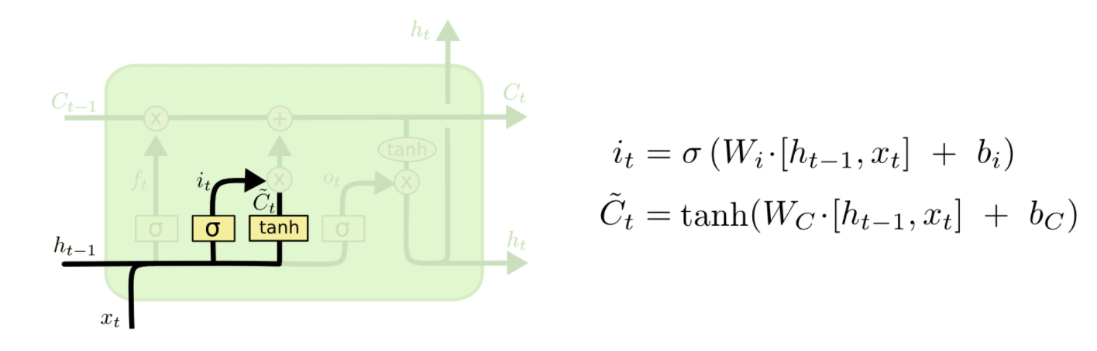
LSTM – Step by Step
From: Christopher Olah's blog http://colah.github.io/posts/2015-08-Understanding-LSTMs/

Slide 9
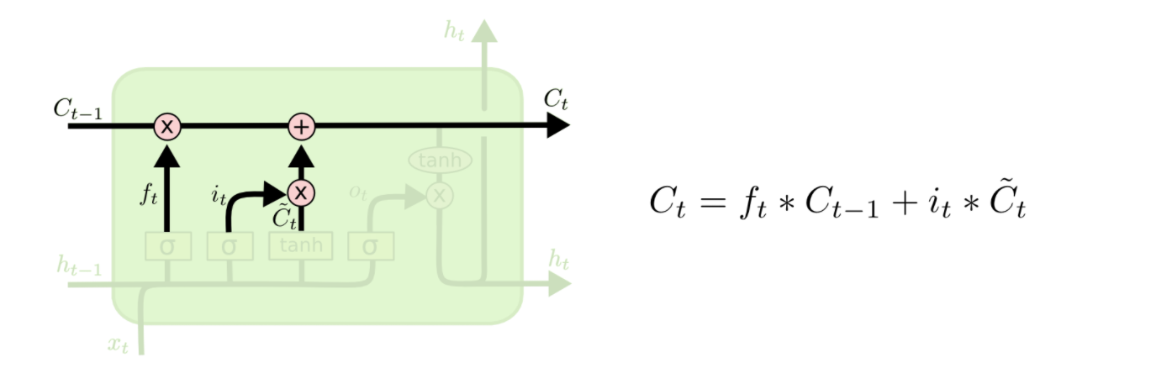
LSTM – Step by Step
From: Christopher Olah's blog http://colah.github.io/posts/2015-08-Understanding-LSTMs/

Slide 10
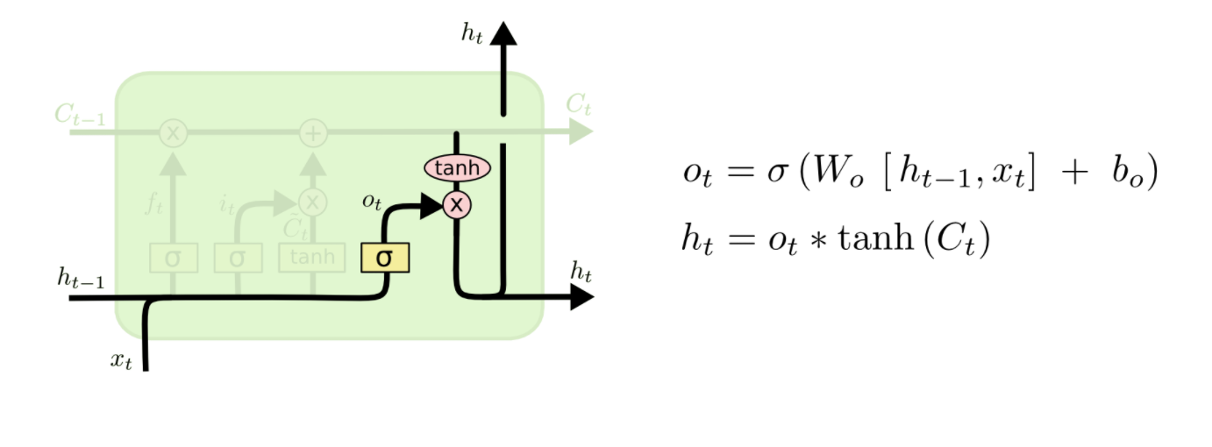
LSTM – Step by Step
From: Christopher Olah's blog http://colah.github.io/posts/2015-08-Understanding-LSTMs/

Slide 11
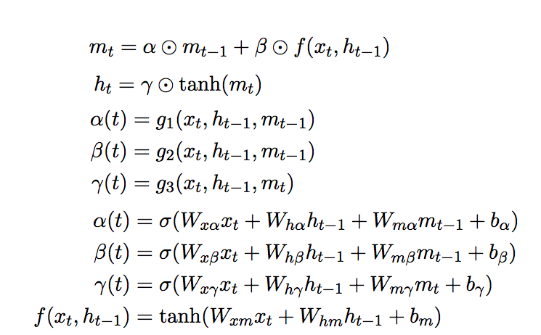
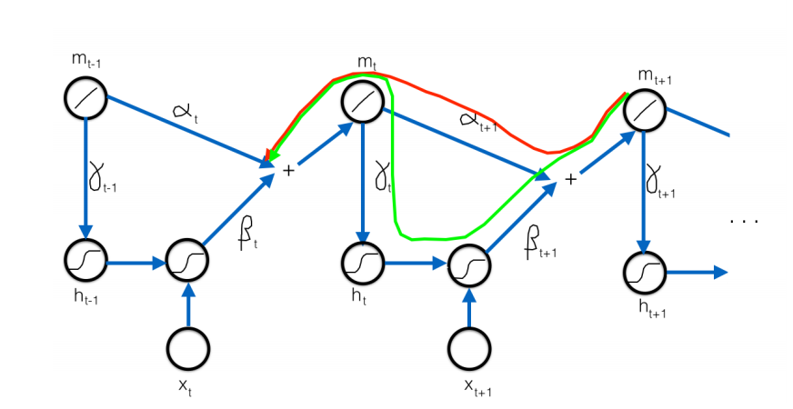
LSTM – Another perspective
From Quoc Le http://cs.stanford.edu/~quocle/tutorial2.pdf
Notes:
In the above figure, the green and the red paths are the two paths that gradient can flow back from mt+1 to mt . I want to emphasize that mt is linearly computed which means the gradient can continue to flow through mt as well. Hence the green path, which generates nonlinear ouputs, is a “difficult” path for gradient to flow; whereas the red path, which only generates linear functions, is an “easy” path for gradient to flow.

Slide 12
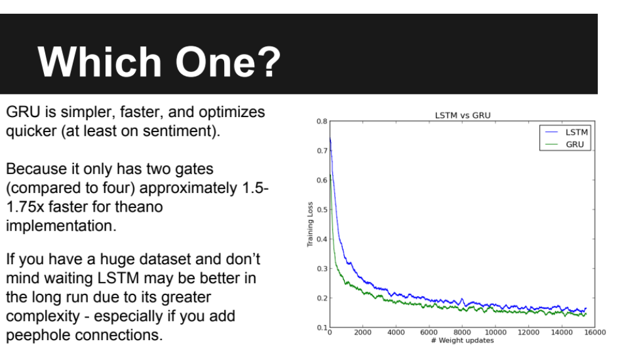
From:Alec Radford generalsequencelearningwithrecurrentneuralnetworksfornextml-150217161745-conversion-gate01.pdf

Slide 13
Adaptive Learning/Momentum
Many different options for adaptive learning/momentum:
  AdaGrad, AdaDelta, Nesterov’s Momentum, Adam
Methods used in NNMT papers:
  Devlin 2014 – Plain SGD
  Sutskever 2014 – Plain SGD + Clipping
  Bahdanau 2014 – AdaDelta
  Vinyals 2015 (“A neural conversation model”) – Plain SGD + Clipping for small model, AdaGrad for large model
Problem: Most are not friendly to sparse gradients
  Weight must still be updated when gradient is zero
  Very expensive for embedding layer and output layer
  Only AdaGrad is friendly to sparse gradients

Slide 14
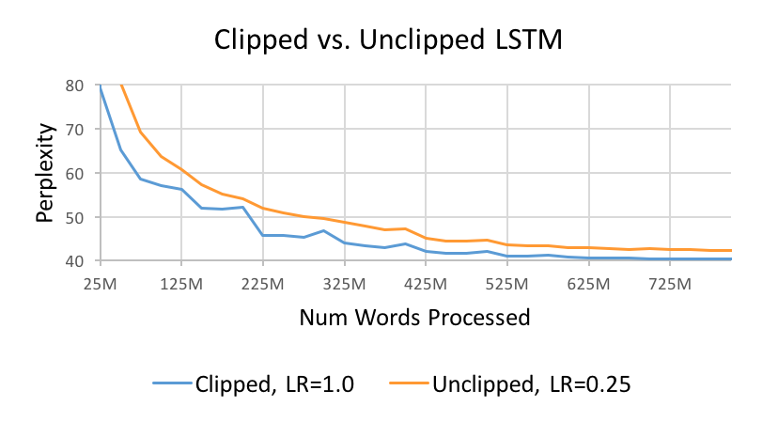
Adaptive Learning/Momentum
For LSTM LM, clipping allows for a higher initial learning rate
  On average, only 363 out of 44,819,543 gradients are clipped per update with learning rate = 1.0
  But the overall gains in perplexity from clipping are not very large
Model | Learning Rate | Perplexity
10-gram FF NNLM | - | 52.8
LSTM LM w/ Clipping | 1.0 | 41.8
LSTM LM No Clipping | 1.0 | Degenerate
LSTM LM No Clipping | 0.5 | Degenerate
LSTM LM No Clipping | 0.25 | 43.2

Slide 15
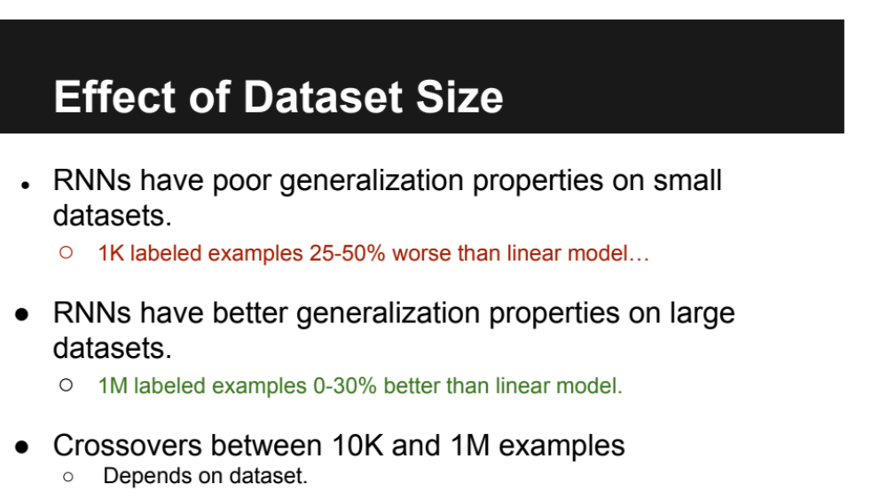
From:Alec Radford generalsequencelearningwithrecurrentneuralnetworksfornextml-150217161745-conversion-gate01.pdf

Slide 16
Discuss …
What is the intuition behind the attention method working ?
Will uni-directional RNN (instead of Bi-direction) and feed input sentence and reverse of input sentence separately and sequentially one after the other(without changing the weight matrix). And achieve almost the same efficiency ?
How much information is just enough information to predict the rest of the sentence in statistical language modeling?

Slide 17
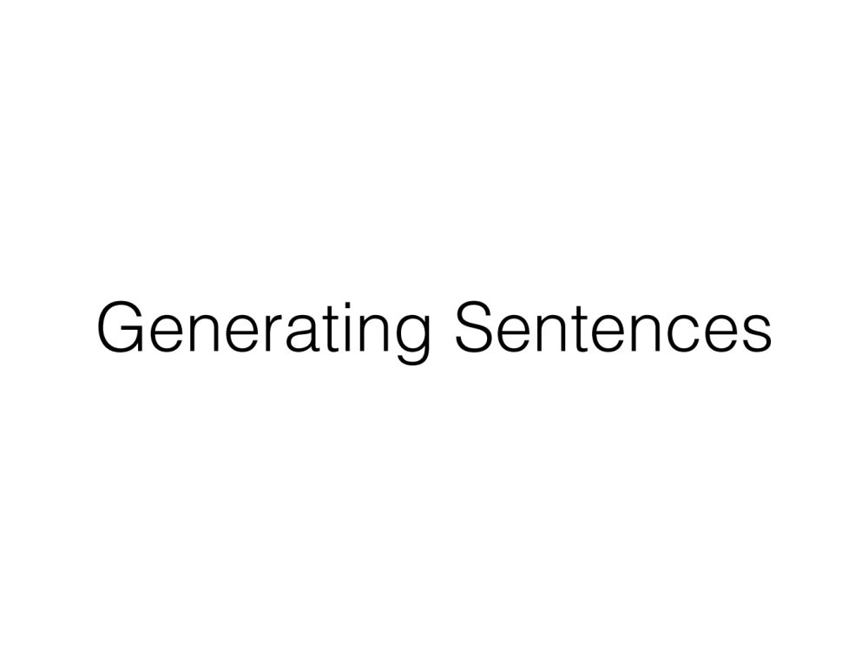

Slide 18
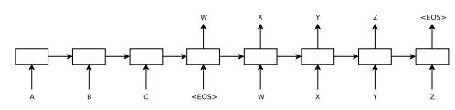
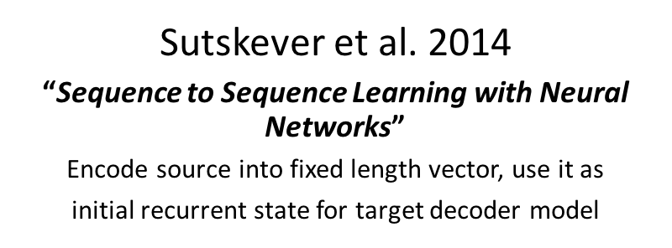
Sequence to Sequence Model

Slide 19
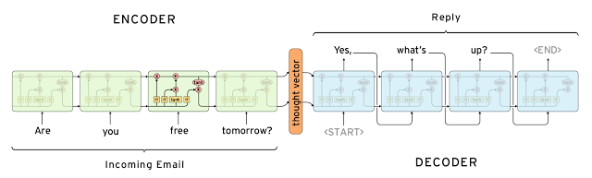
Sequence to Sequence Model

Slide 20
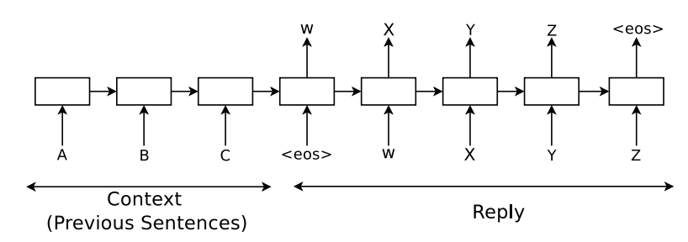
Sequence to Sequence Model
What is the loss function for the sequence to sequence?
Does it make sense?
Notes:
1/|S| \sum_{(T,S) \in \script{S}}{\log(p(T|S)}

Slide 21

Sequence to Sequence Model
Notes:
1/|S| \sum_{(T,S) \in \script{S}}{\log(p(T|S)}

Slide 22

Sequence to Sequence Model
Notes:
1/|S| \sum_{(T,S) \in \script{S}}{\log(p(T|S)}

Slide 23
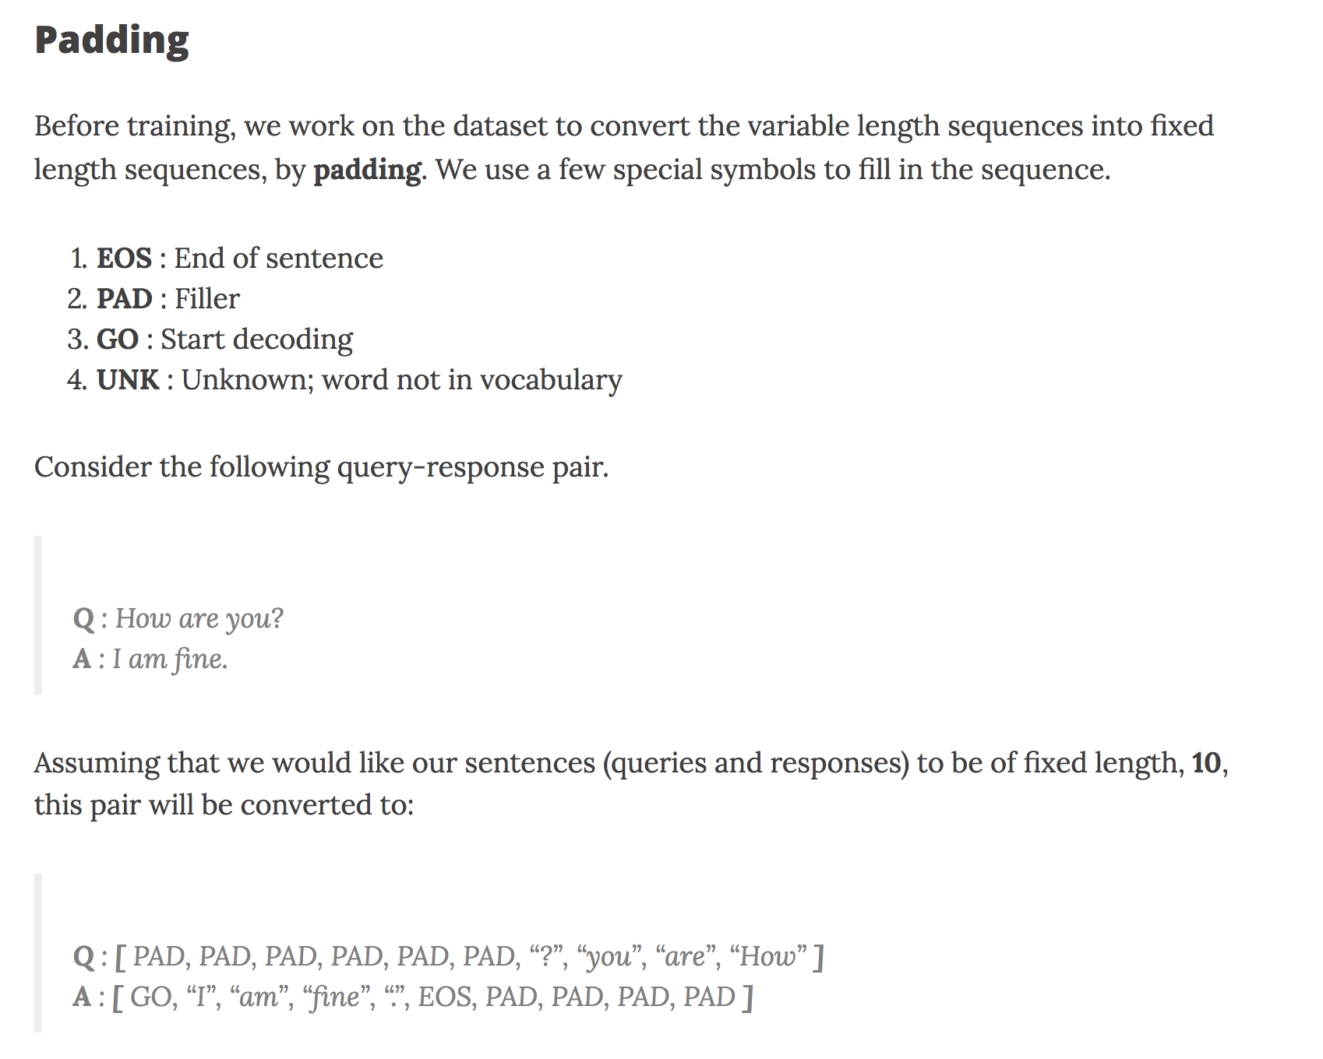

Slide 24
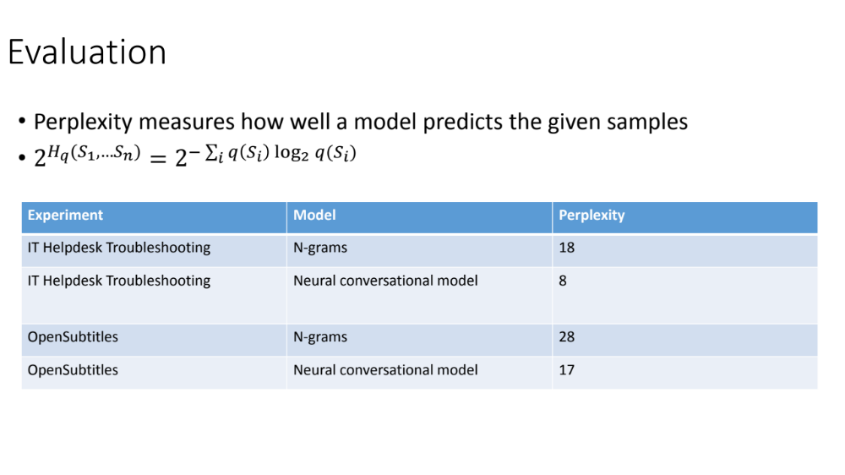
From: Berkay Antmen http://www.cs.toronto.edu/~fidler/teaching/2015/slides/CSC2523/conversation_berkay.pdf

Slide 25
Dataset
Why movie scripts?

Slide 26
Dataset
Why movie scripts?
  Large dataset (13 M works, 10M training)
  Multiple topics
  Closer to spoken language
  Few number of participants
  Clean data [ few misspellings and unknown words ]
  Mostly single thread

Slide 27
Questions
1. Has the reverse of the reranking procedure been done where an SMT system was used to rerank hypothesis performed by an LSTM system?
2. In the seq2seq paper, a beam search decoder is used, whereas in the neural conversational paper, a "greedy" inference approach is used - what are the relative advantages of either approach? (The first paragraph of "3. Model" is the source of this question, as it discusses an approach before mentioning "beam search".)
3. What can be done to help the neural conversation model have a more 'consistent personality' to similarly answer semantically similar but not identical questions?

Slide 28
Questions
1. Will reversing the order of words from the source sentence still improve the performance for languages that has a different word order from French? (English and French are SOV or SVO vs Tagalog with VOS)
2. Why did they use SGD for the IT Help desk experiment and AdaGrad for the OpenSubtitles Experiment?
3. Why movie conversations as a choice of dataset for basic conversations? Can't they have used Google Hangout data that was anonymized since this was a Google research?

Slide 29
Questions
1. How does ensuring that all sentences within a minibatch are roughly of same length gives speedup?
2. Is there any particular reason that in tensorflow seq2seq we train different models for each bucket?
3. 160,000 most frequent words were used from source language and 80,000 from target language. Is there any particular reason for this huge difference in the word count?

Slide 30
Questions
Why was a momentum based optimizer not used in the seq2seq model ?
Why do LSTMs not suffer from vanishing gradients, but still suffer from exploding gradients?
Is the "left to right beam search" simply a greedy search?

Slide 31
Questions
1. Are there any special language properties of English and French that were exploited for the infrastructure of the models?
2. What would be the effect of reversing target but not source?
3. How do you infuse personality in a bot?

Slide 32
Questions
1) In the paper "Sequence To Sequence Learning with Neural Networks", the researchers suggested to generally take the mini batches from the sentences of same length which would result in 2X speed. Are they referring to the length of the input sequences? Would the computation not depend on the length of the output sequences as well and if the length of the output sequences vary, would that not cause a slow down in the computation?
2) I am not exactly clear on how does the soft attention mechanism of peeking into the input help in the increasing the accuracy of the model? What could be the possible reasons that the mechanism did not seem to work for the conversational agent?
3) While training a conversational agent, generally a context of previous utterances is fed along-with what is the current utterance. But when the topic of a conversation changes, the context might very different from what is being said now? How does one prevent the LSTM based model from learning relations using contexts in these scenarios?

Slide 33
Questions
Q. The authors of the paper have used left to right beam search while generating the responses. They also mentioned that this approach is better than naive greedy approach of just putting all the words(tokens) as the candidate for the next prediction. I am not able to figure out any better way than beam search. Is there any better way in which we can imagine better candidates for the prediction in the next iteration.
Is my understanding correct : attention mechanism only gives extra information ( to the decoder phase ) and if it is not useful, the model will automatically disregard it as it checks through validation set at each iteration. So, there is no harm in implementing seq-to-seq with attention mechanism except from the fact that model is little more complex ?
How to decide how much should be the input context in the encoder during a dialog conversation. For e.g. if the sequence of dialogue between two person is : <P1 : Sentence -1 > <P2: Sentence-2> <P1: Sentence-3>. So should the response context of Sentence-4 contain all these three sentences merged in the input of encoder. Or, just sentences spoken by Person P1 ?

Slide 34
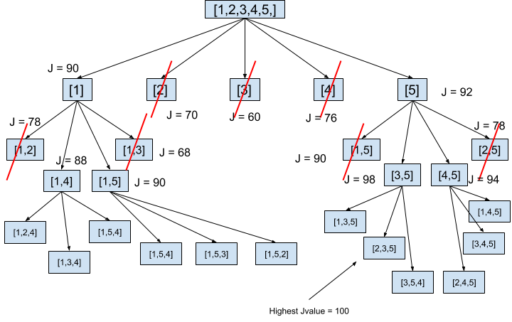
Beam Search – pick n best alternatives of length k
From:
Parinda Rajapaksha http://www.slideshare.net/parindarajapaksha/analysis-of-feature-selection-algorithms

